Slide 1

Introduction to Spring Boot
danlucian.net

Slide 2

What is Spring? But wait… what is Spring Boot?
Notes:
The Spring Framework is divided into modules. Applications can choose which modules they need. At the heart are the modules of the core container, including a configuration model and a dependency injection mechanism. Beyond that, the Spring Framework provides foundational support for different application architectures, including messaging, transactional data and persistence, and web. It also includes the Servlet-based Spring MVC web framework and, in parallel, the Spring WebFlux reactive web framework.

Slide 3
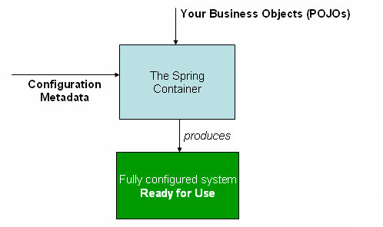
What’s all about?
By contrast with traditional programming, in which our custom code makes calls to a library, IoC enables a framework to take control of the flow of a program and make calls to our custom code. In order to make this possible, frameworks are defined through abstractions with additional behavior built in.
If we want to add our own behavior, we need to extend the classes of the framework or plugin our own classes.
Notes:
Library vs Framework: IoC
The advantages of this architecture are:
decoupling the execution of a task from its implementation
making it easier to switch between different implementations
greater modularity of a program
greater ease in testing a program by isolating a component or mocking its dependencies and allowing components to communicate through contracts
Inversion of Control can be achieved through various mechanisms such as: Strategy design pattern, Service Locator pattern, Factory pattern, and Dependency Injection (DI).
In the Spring framework, the IoC container is represented by the interface ApplicationContext. The Spring container is responsible for instantiating, configuring and assembling objects known as beans, as well as managing their lifecycle.
The Spring framework provides several implementations of the ApplicationContext interface — ClassPathXmlApplicationContext and FileSystemXmlApplicationContext for standalone applications, and WebApplicationContext for web applications.
In order to assemble beans, the container uses configuration metadata, which can be in the form of XML configuration or annotations.

Slide 4
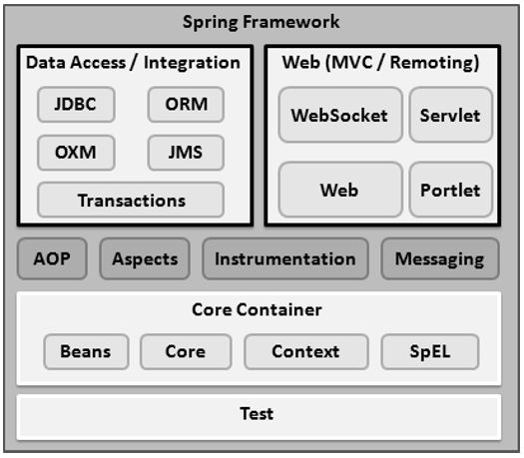
Spring Framework
Spring could potentially be a one-stop shop for all your enterprise applications.
However, Spring is modular, allowing you to pick and choose which modules are applicable to you, without having to bring in the rest. The Spring Framework provides about 20 modules which can be used based on an application requirement.

Slide 5
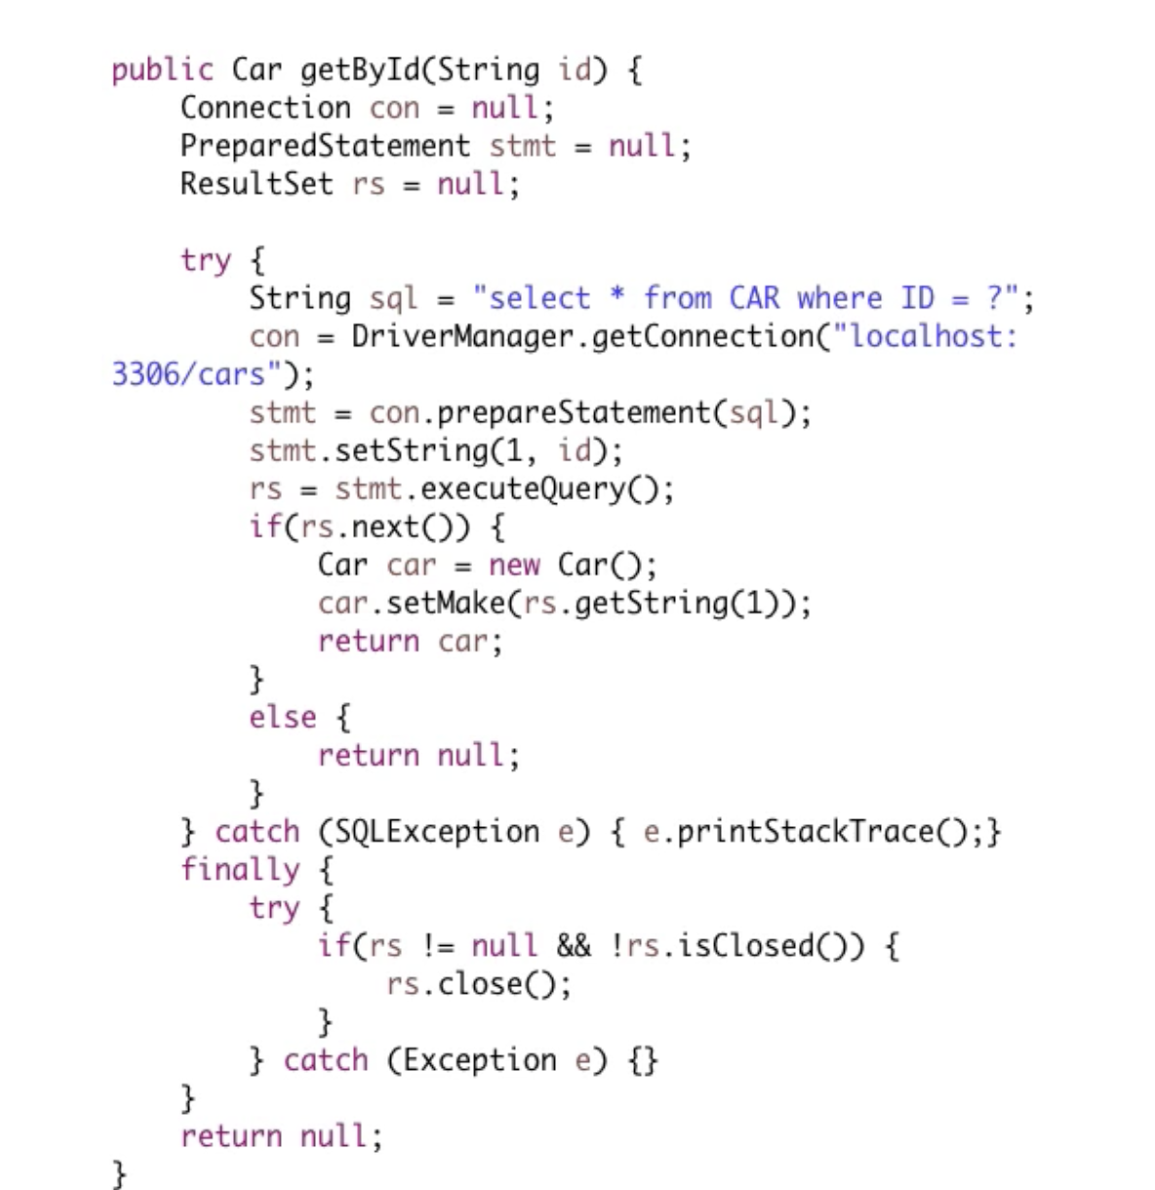
what we care about
public interface CarRepository extends CrudRepository<Car,Long> {
Car findById(Long carId);
}

Slide 6
Inversion of Control

Slide 7
Dependency Injection
JSR 330
Notes:
JSR - Java Specification Request

Slide 8
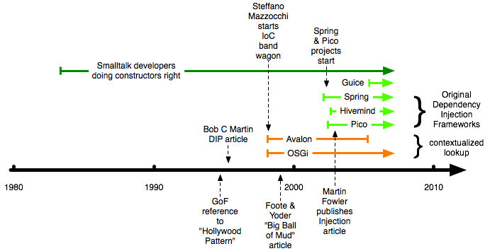
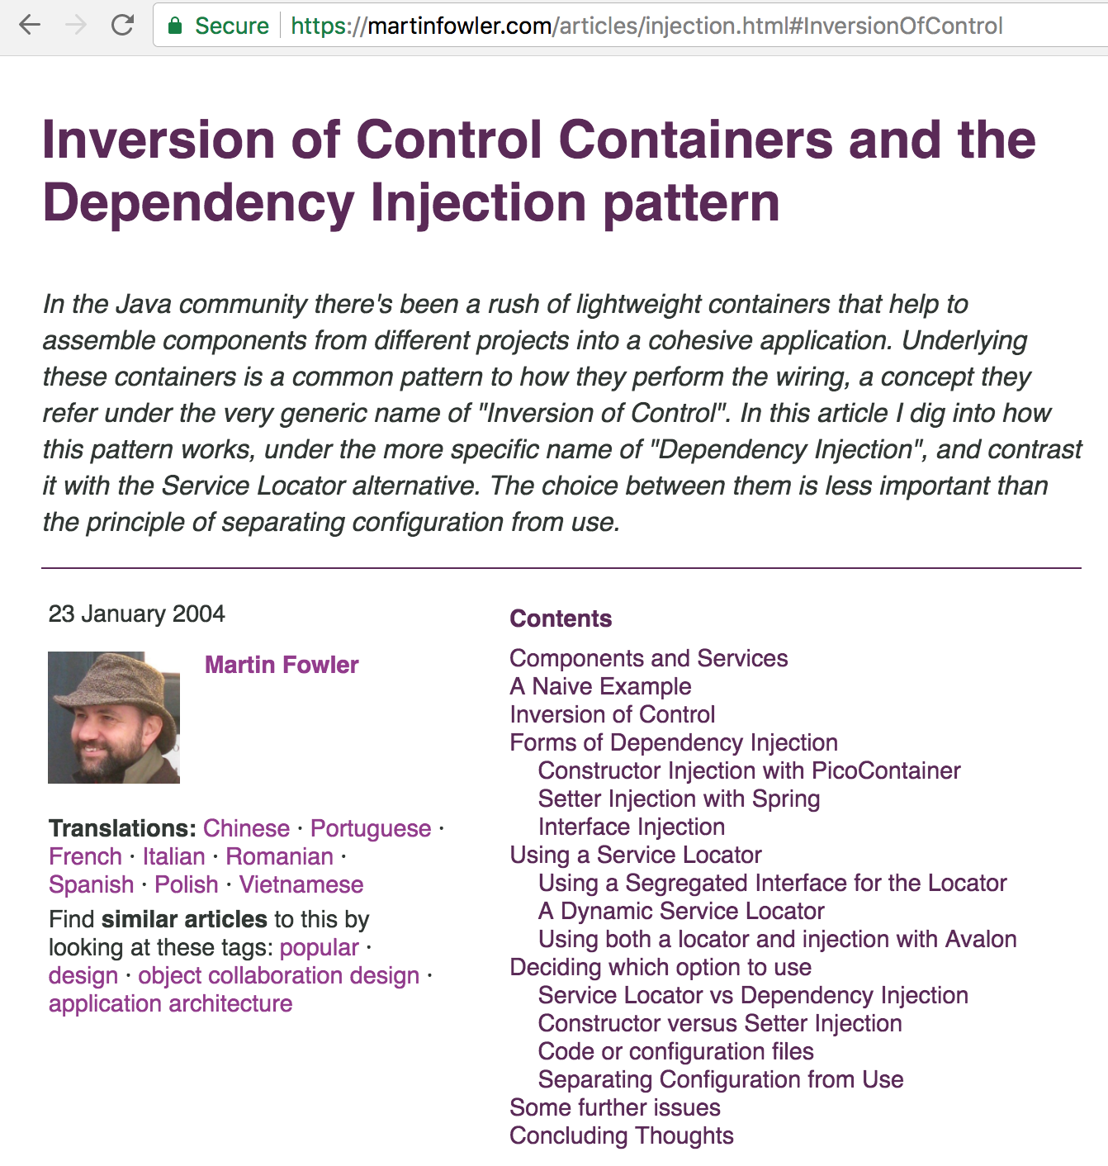
Inversion of Control? Dependency Injection?
https://martinfowler.com/articles/injection.html
Notes:
started as IoC container;
development without EJB;
reducing the complexity of JEE;
enterprise development without an application server;
POJO BASED + INTERFACE DRIVEN, write better and cleaner code and do things without too much fuss
Inainte de spring, JEE Blueprints (design patterns)
WORA (writte once, run everywhere)

Slide 9
The IoC Container and Bean Scopes
Notes:
Singleton Scopes a single bean definition to a single object instance per Spring IoC container.
Prototype Scopes a single bean definition to any number of object instances.
Request Scopes a single bean definition to the lifecycle of a single HTTP request; that is each and every HTTP request will have its own instance of a bean created off the back of a single bean definition. Only valid in the context of a web-aware SpringApplicationContext.
Session Scopes a single bean definition to the lifecycle of a HTTP Session. Only valid in the context of a web-aware SpringApplicationContext.
global session Scopes a single bean definition to the lifecycle of a global HTTP Session. Typically only valid when used in a portlet context. Only valid in the context of a web-aware Spring ApplicationContext.

Slide 10
JSR 250
Notes:
@PostConstruct / @PreDestroy

Slide 11

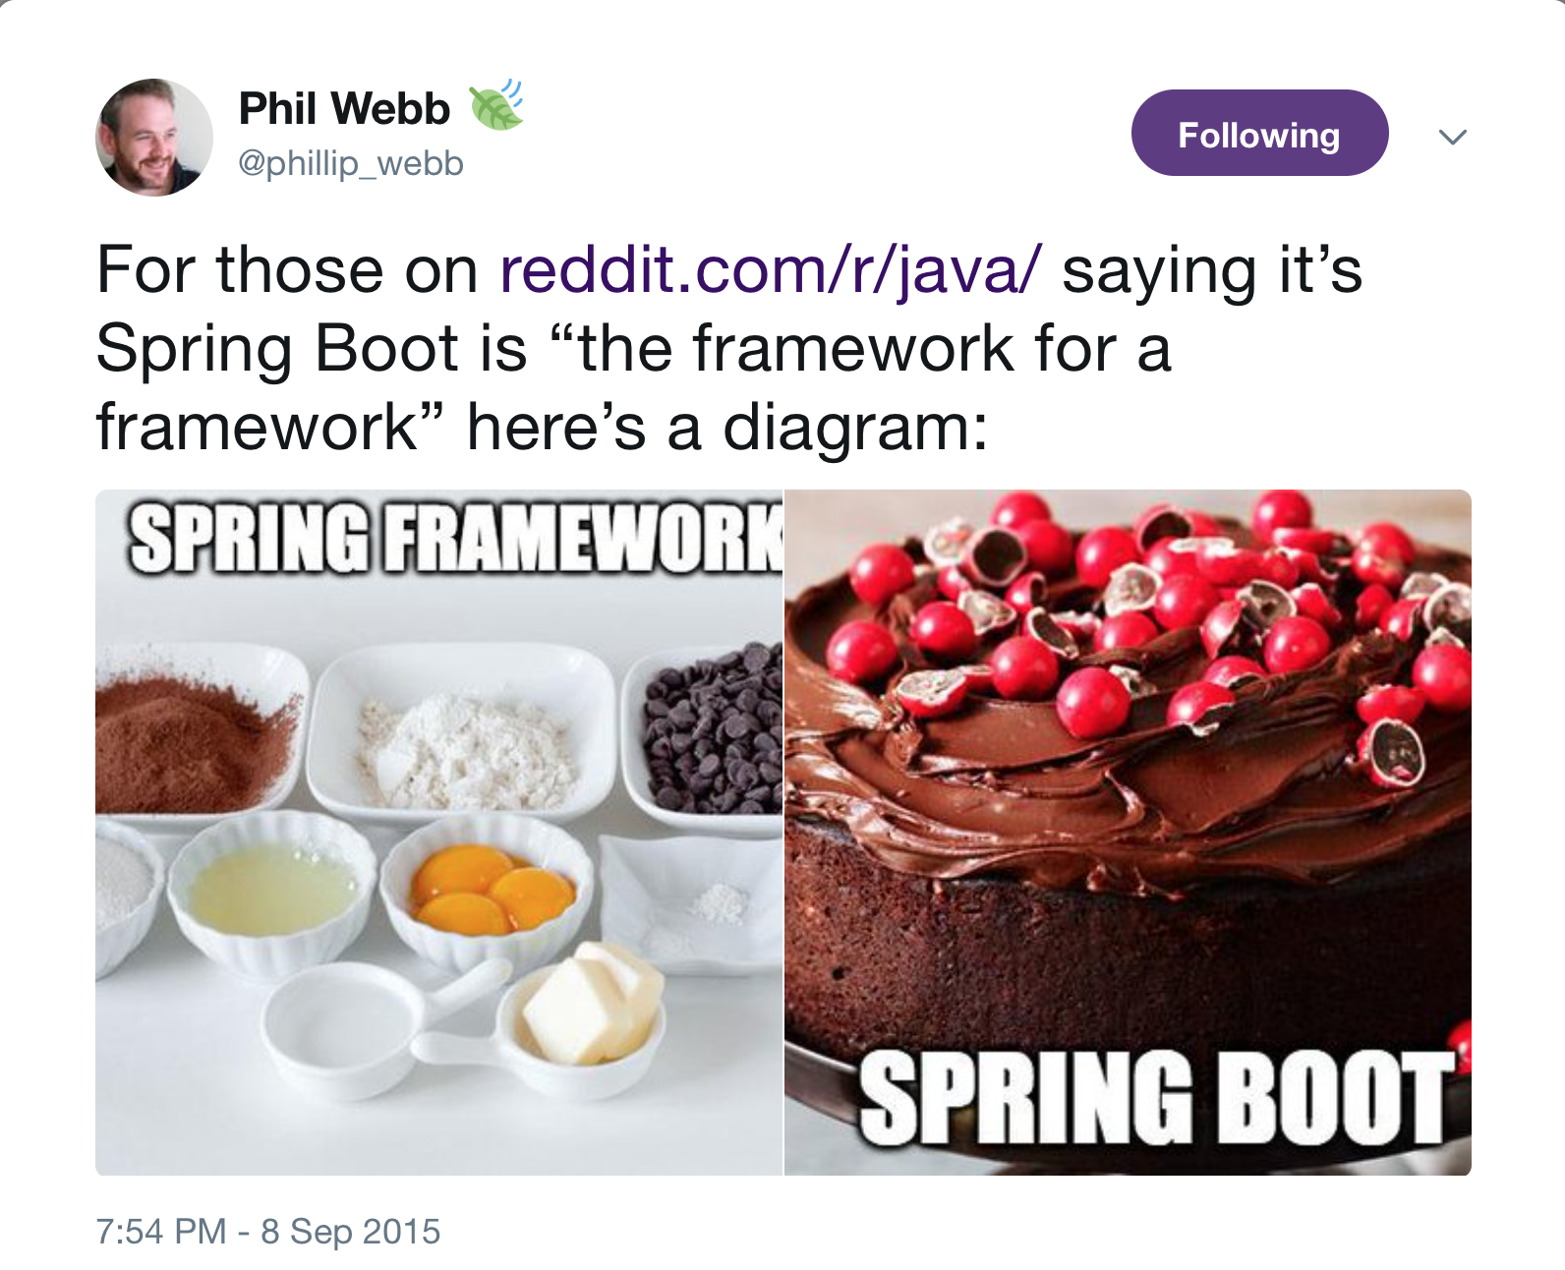
Let’s introduce Spring Boot

Slide 12
Spring Boot makes it easy to create stand-alone, production-grade Spring based applications that you can "just run".
Notes:
Create stand-alone Spring applications
Embed Tomcat, Jetty or Undertow directly (no need to deploy WAR files)
Provide opinionated 'starter' POMs to simplify your Maven configuration
Automatically configure Spring whenever possible
Provide production-ready features such as metrics, health checks and externalized configuration
Absolutely no code generation and no requirement for XML configuration

Slide 13
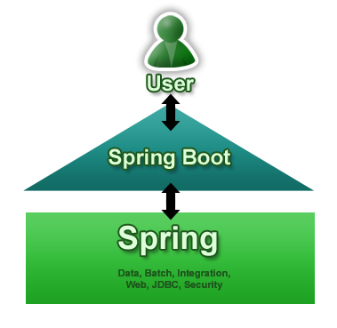
Spring Boot aims to make it easy to create Spring-powered, production-grade applications and services with minimum fuss. It takes an opinionated view of the Spring platform so that new and existing users can quickly get to the bits they need. You can use it to create stand-alone Java applications that can be started using ‘java -jar’ or more traditional WAR deployments. We also provide a command line tool that runs ‘spring scripts’.
Spring Boot does not generate code and there is absolutely no requirement for XML configuration.

Slide 14




Embedded servlet containers
Notes:
Apache Tomcat - Apache Foundation
Jetty - Eclipse OSS
Netty - Originally developed by JBoss, Netty is now developed and maintained by the Netty Project Community
Undertow - Undertow is sponsored by JBoss and is the default web server in the Wildfly Application Server, Redhat

Slide 15
Comparison of Spring Boot Embedded Servlet Containers
TOMCAT
Label | # Samples | Average | Min | Max | Std. Dev. | Error % | Throughput | Received KB/sec | Sent KB/sec | Avg. Bytes
Startup | 3000 | 7 | 1 | 549 | 35.78374361 | 0 | 293.8583603 | 55.95935572 | 55.67238466 | 195
Others | 3000 | 1 | 0 | 45 | 1.359661682 | 0 | 287.8802418 | 54.82094449 | 54.53981144 | 195
Others | 3000 | 1 | 0 | 24 | 1.155032275 | 0 | 292.1129503 | 55.62697785 | 55.3417113 | 195
JETTY
Label | # Samples | Average | Min | Max | Std. Dev. | Error % | Throughput | Received KB/sec | Sent KB/sec | Avg. Bytes
Startup | 3000 | 7 | 0 | 561 | 40.13705065 | 0 | 291.5168594 | 56.0828333 | 55.22878 | 197
Others | 3000 | 1 | 0 | 21 | 1.058925031 | 0 | 293.5995302 | 56.48350338 | 55.6233485 | 197
Others | 3000 | 1 | 0 | 21 | 0.926034317 | 0 | 294.3485086 | 56.62759395 | 55.7652448 | 197
UNDERTOW
Label | # Samples | Average | Min | Max | Std. Dev. | Error % | Throughput | Received KB/sec | Sent KB/sec | Avg. Bytes
Startup | 3000 | 6 | 0 | 451 | 31.6188702 | 0 | 295.6830278 | 63.81440346 | 56.01807363 | 221
Others | 3000 | 1 | 0 | 22 | 1.255447862 | 0 | 292.7400468 | 63.17924839 | 55.46051669 | 221
Others | 3000 | 1 | 0 | 18 | 1.559477975 | 0 | 294.3773918 | 63.53262069 | 55.77071681 | 221
Notes:
Throughput tests

Slide 16
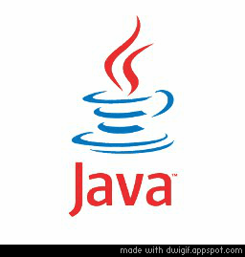
Comparison of Spring Boot Embedded Servlet Containers
TOMCAT
Heap Size: 697,827,328 B
Used: 124,260,976 B
Max: 2,147,483,648 B
Threads: 17 Live, 22 Started
JETTY
Heap Size: 628,621,312 B
Used: 311,476,776 B
Max: 2,147,483,648 B
Threads: 19 Live, 22 Started
UNDERTOW
Heap Size: 630,718,464 B
Used: 114,599,536 B
Max: 2,147,483,648 B
Threads: 17 Live, 20 Started
Notes:
Memory usage tests

Slide 17
Spring Boot features overview
https://docs.spring.io/spring-boot/docs/current/reference/htmlsingle/
Notes:
Memory usage tests

Slide 18

Surprize! We’ve got a BOM!
Notes:
BOM (bill of materials) -> dependency management ("nearest definition", "dependency mediation")
-> dependency management node or parent (case of spring boot)
A -> B -> C -> D 1.4 and A -> E -> D 1.0;
Artifact D 1.0 will be used in the build of A project because the path through E is shorter.

Slide 19
start.spring.io

Slide 20

Congrats! You are now licensed in Spring+Boot!

